Slide 1
Random Forest (RF)
Data Analytics - WQD 7003

Slide 2
Random Forest (RF)
What is the RF algorithm?
Random forest is a tree-based algorithm which involves building several trees (decision trees), then combining their output to improve generalization ability of the model. The method of combining trees is known as an ensemble method. Ensembling is nothing but a combination of weak learners (individual trees) to produce a strong learner.
Say, you want to watch a movie. But you are uncertain of its reviews. You ask 10 people who have watched the movie. 8 of them said " the movie is fantastic." Since the majority is in favor, you decide to watch the movie. This is how we use ensemble techniques in our daily life too.
Random Forest can be used to solve regression and classification problems. In regression problems, the dependent variable is continuous. In classification problems, the dependent variable is categorical.

Slide 3
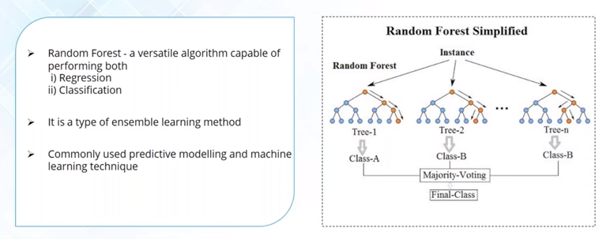
Random Forest

Slide 4
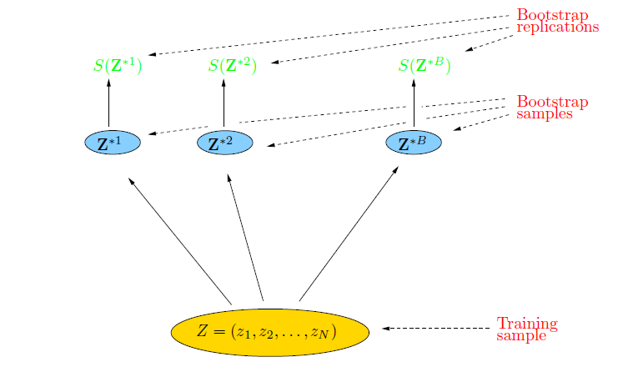
Bootstrap
The basic idea:
randomly draw datasets with replacement from the
training data, each sample the same size as the original training set
Ref: https://www.cs.cmu.edu › ~ggordon › recitations › rec08 › Rec08_Oct21

Slide 5
Bagging
Create bootstrap samples
from the training data
M features
N examples
....…
Ref: https://www.cs.cmu.edu › ~ggordon › recitations › rec08 › Rec08_Oct21

Slide 6
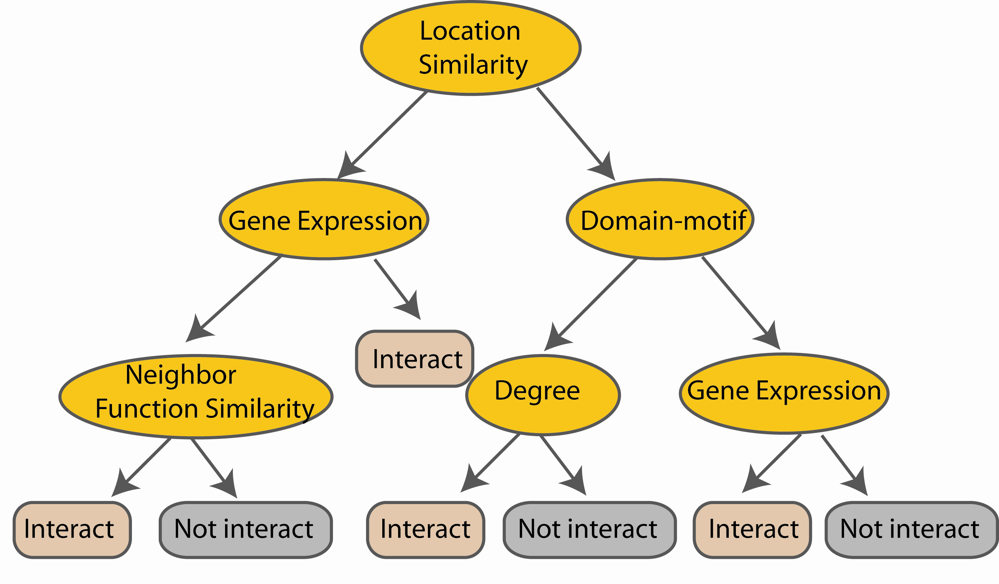
Random Forest Classifier
Construct a decision tree
M features
N examples
....…
Ref: https://www.cs.cmu.edu › ~ggordon › recitations › rec08 › Rec08_Oct21

Slide 7

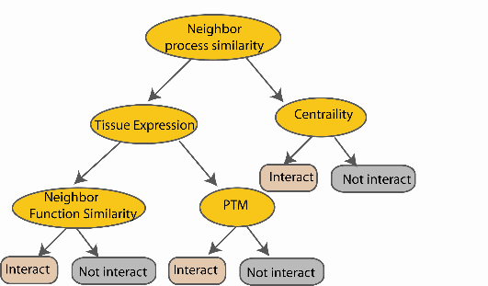
Random Forest Classifier
M features
N examples
Take the majority vote
....…
....…
Ref: https://www.cs.cmu.edu › ~ggordon › recitations › rec08 › Rec08_Oct21
Notes:
Finally the given an input data the decision is made as follows given an input data,

Slide 8
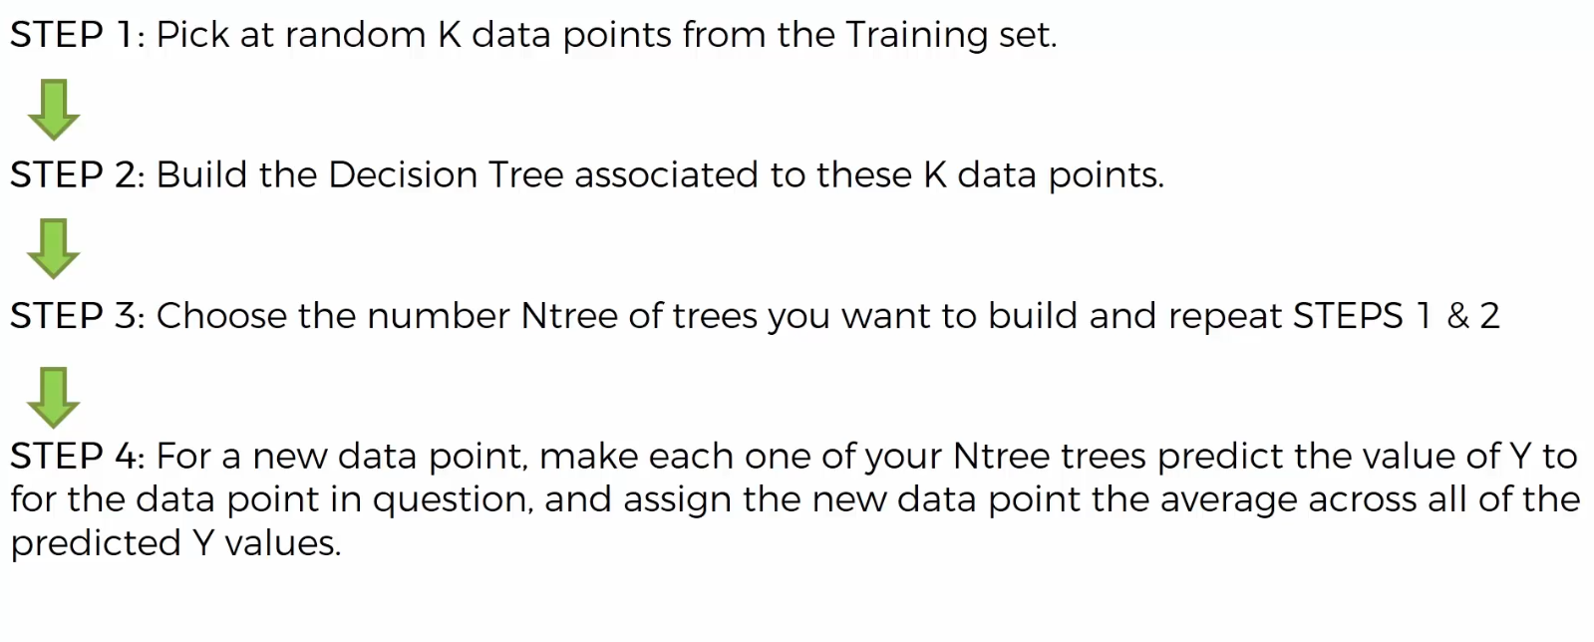
Random Forest (RF)
Basic steps:

Slide 9
Random Forest (RF)
How does it work? (Decision Tree, RF)
First, it uses the Bagging (Bootstrap Aggregating) algorithm to create random samples. Given a data set D1 (n rows and p columns), it creates a new dataset (D2) by sampling n cases at random with replacement from the original data. About 1/3 of the rows from D1 are left out, known as Out of Bag(OOB) samples.
Then, the model trains on D2. OOB sample is used to determine unbiased estimate of the error.
Out of p columns, the P columns are selected at random. Usually, the default choice of P is p/3 for regression tree and P is sqrt(p) for classification tree.
Unlike a tree, no pruning takes place in random forest; i.e, each tree is grown fully. In decision trees, pruning is a method to avoid overfitting. Pruning means selecting a subtree that leads to the lowest test errror rate. We can use cross validation to determine the test error rate of a subtree.
Several trees are grown and the final prediction is obtained by averaging or voting.

Slide 10
The idea behind RF
The idea is that instead of producing a single complicated and complex Model which might have a high variance which will lead to Over fitting or might be too simple and have a high bias which leads to Under fitting, we will generate lots of Models by training on Training Set and at the end combine them.
Such a technique is Random Forest which is a popular Ensembling technique is used to improve the predictive performance of Decision Trees by reducing the variance in the Trees by averaging them. Decision Trees are considered very simple and easily interpretable as well as understandable Modeling techniques, but a major drawback in them is that they have a poor predictive performance and poor Generalization on Test Set.

Slide 11
The idea behind RF
Random Forests are similar to a famous Ensemble technique called Bagging but have a different tweak in it. In Random Forests the idea is to decorrelate the several trees which are generated on the different bootstrapped samples from training data and then we simply reduce the variance in the trees by averaging them. Averaging the Trees helps us to reduce the variance and also improve the performance of Decision Trees on Test Set and eventually avoid Over fitting.
The idea is to build lots of Trees in such a way to make the Correlation between the Trees smaller.
However, every time a split has to made, it uses only a small random subset of features to make the split instead of the full set of features (usually (sqrt[]{p}), where p is the number of predictors). It builds multiple trees using the same process, and then takes the average of all the trees to arrive at the final model. This works by reducing the amount of correlation between trees, and thus helping reduce the variance of the final tree.

Slide 12
Random Forest (RF)
Advantages of RF
It is robust to correlated predictors.
It is used to solve both regression and classification problems.
It can be also used to solve unsupervised ML problems.
It can handle thousands of input variables without variable selection.
It can be used as a feature selection tool using its variable importance plot.
It takes care of missing data internally in an effective manner.
Disadvantages of RF
The Random Forest model is difficult to interpret.
It tends to return erratic predictions for observations out of range of training data. For example, the training data contains two variable x and y. The range of x variable is 30 to 70. If the test data has x = 200, random forest would give an unreliable prediction.
It can take longer than expected time to computer a large number of trees.

